Slide 1
Bell Work (7 – 10 minutes): 1.) Write the equation, and graph the line through (3, 10) and (0, 1) 2.) Write the equation of the line through the point (-6, 1) and parallel to y=3x+8 3.) Also, state the domain and range.

Slide 2
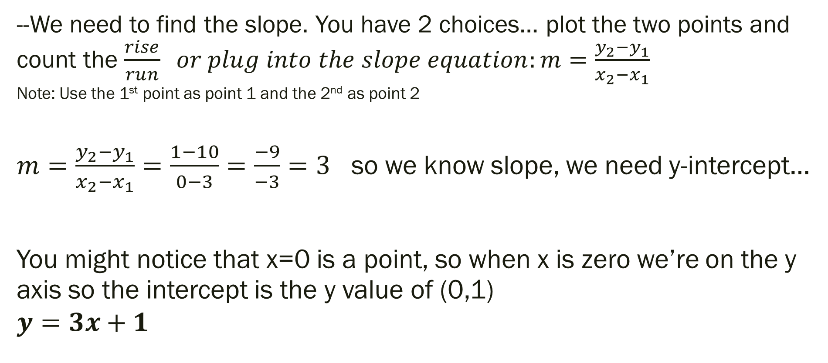
Bell Work Explained: 1.) Write the equation, and graph the line through (3, 10) and (0, 1)
--We need to find the slope. You have 2 choices… plot the two points and count the $\frac{rise}{run} or plug into the slope equation:m=\frac{y_{2}−y_{1}}{x_{2}−x_{1}}$ Note: Use the 1st point as point 1 and the 2nd as point 2
$m=\frac{y_{2}−y_{1}}{x_{2}−x_{1}}=\frac{1−10}{0−3}=\frac{−9}{−3}=3$ so we know slope, we need y-intercept…
You might notice that x=0 is a point, so when x is zero we’re on the y axis so the intercept is the y value of (0,1)
$$y=3x+1$$

Slide 3
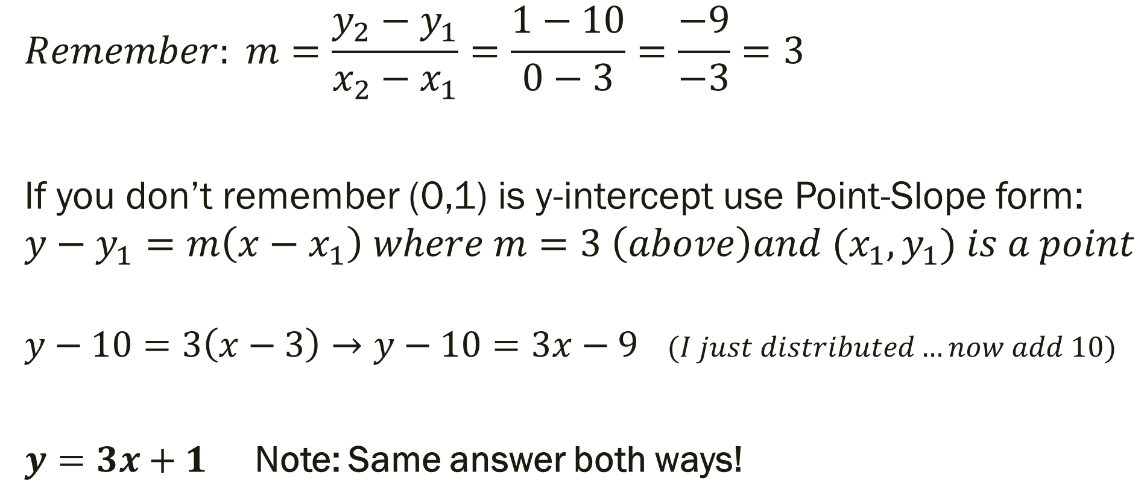
Bell Work Explained: 1.) Write the equation, and graph the line through (3, 10) and (0, 1)
$$Remember: m=\frac{y_{2}−y_{1}}{x_{2}−x_{1}}=\frac{1−10}{0−3}=\frac{−9}{−3}=3$$
If you don’t remember (0,1) is y-intercept use Point-Slope form:
$${y−y}_{1}=m\left(x−x_{1}\right) where m=3 \left(above\right)and{ (x}_{1},y_{1}) is a point$$
$y−10=3\left(x−3\right)→y−10=3x−9$ $(I just distributed…now add 10)$
$y=3x+1$ Note: Same answer both ways!

Slide 4
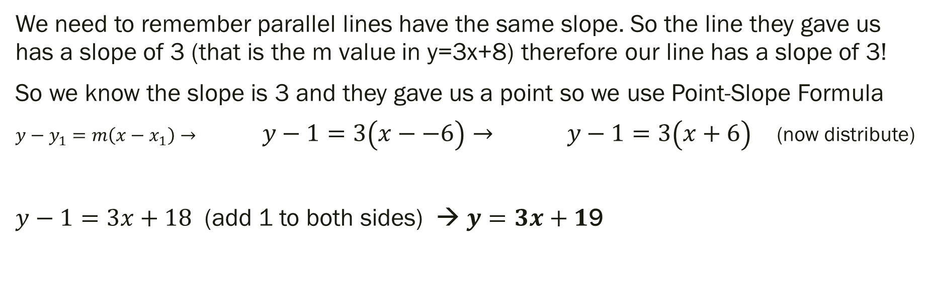
Bell Work Explained: 2.) Write the equation of the line through the point (-6, 1) and parallel to y=3x+8
We need to remember parallel lines have the same slope. So the line they gave us has a slope of 3 (that is the m value in y=3x+8) therefore our line has a slope of 3!
So we know the slope is 3 and they gave us a point so we use Point-Slope Formula
${y−y}_{1}=m\left(x−x_{1}\right)→ y−1=3\left(x−−6\right)→ y−1=3\left(x+6\right)$ (now distribute)
$y−1=3x+18$ (add 1 to both sides) → $y=3x+1$9

Slide 5
Bell Work Explained: Also, state the domain and range.
We can think of the domain as whatever x values are input into the equation for now.
So just list out all of the x values… this is A LOT of numbers so in this case we can just say everything is part of the domain – because you can use any x you want!
We can think of the range as whatever y values are output from the equation for now.
So just list out all of the y values… this is A LOT of numbers so in this case we can just say everything is part of the range also– because you get any y you want!

Slide 6
Homework From Last Time…
New Material
Page 86 #1, 11, 17, 19, 27, 32
Mixed Review
Page 88 #60, 62, 66, 67

Slide 7
ALGEBRA 3
Day 18

Slide 8
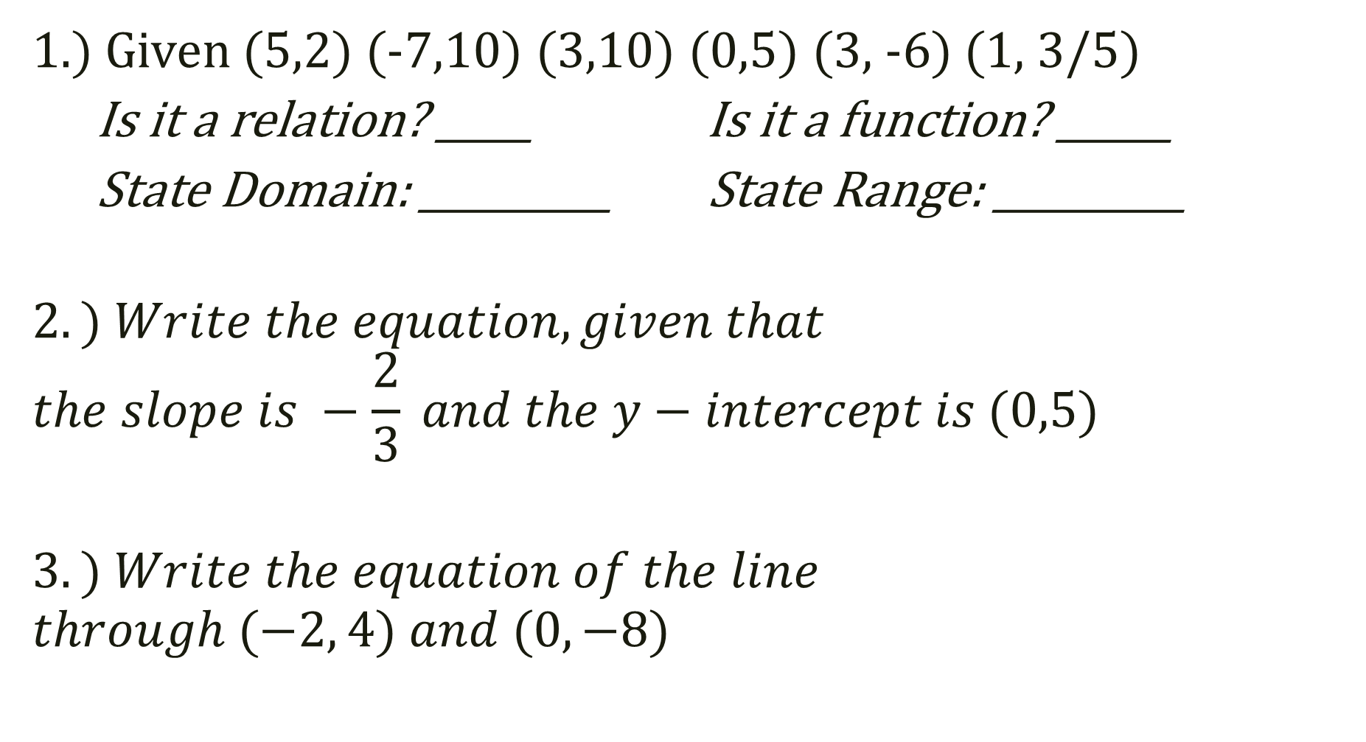
Quiz 1: Level 2 (5 – 9 minutes)
1.) Given (5,2) (-7,10) (3,10) (0,5) (3, -6) (1, 3/5)
Is it a relation? _____ Is it a function? ______
State Domain: __________ State Range: __________
$$2.) Write the equation, given that \\ the slope is −\frac{2}{3} and the y−intercept is (0,5)$$
$$3.) Write the equation of the line \\ through (−2, 4) and (0, −8)$$

Slide 9
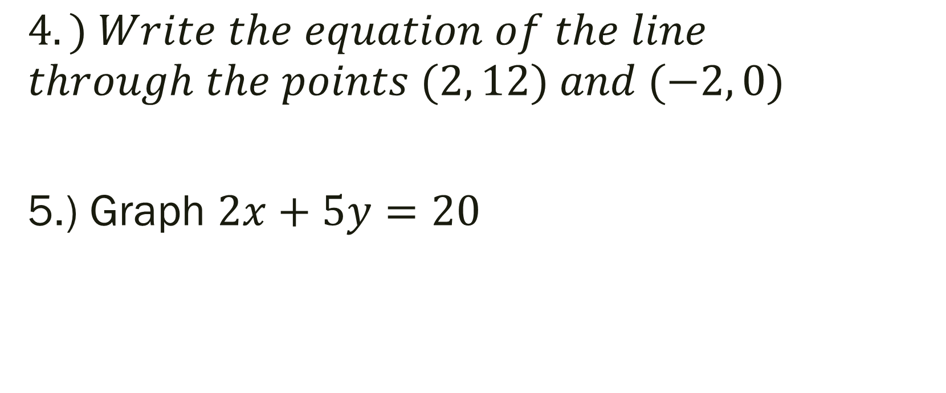
Quiz 1: Level 3 (5 – 7 minutes)
$$4.) Write the equation of the line \\ through the points (2, 12) and (−2, 0)$$
5.) Graph $2x+5y=20$

Slide 10
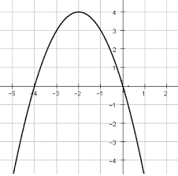
Quiz 1: Level 4 (5 minutes)
6.) Given the graph
at right… describe the
Domain and Range.
What could you do to
the graph for it to NOT
be a function anymore?

Slide 11
Chapter 2 Section 5 Using Linear Equations
Objective: Identify correlation and write equation of best fit
Chapter 2 Section 6 Families of Functions
Objective: Describe the transformation from the parent graph

Slide 12
Chapter 2 Section 5 Using Linear Equations Vocabulary
Scatter Plot – graph used to determine if a relationship exists between paired data
Positive Correlation—y increases as x increases
Negative Correlation—y decreases as x increases
Relatively No Correlation—no linear pattern

Slide 13
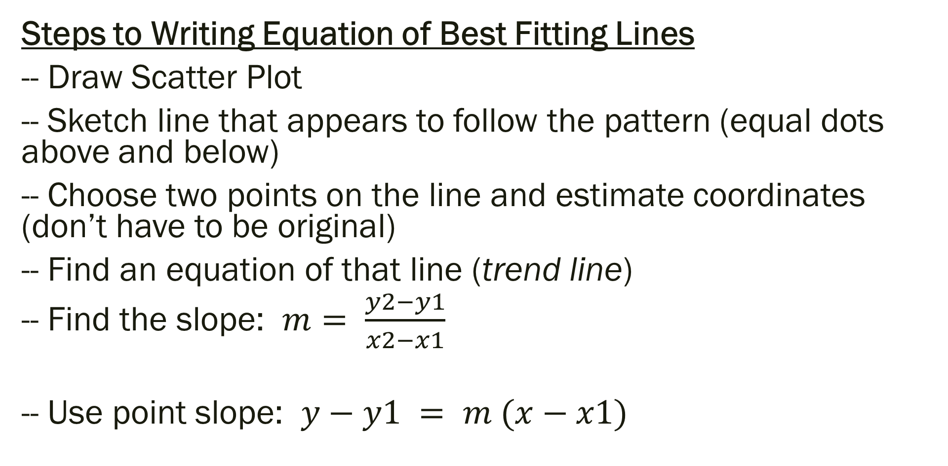
Write the Equation of a Line of Best Fit
Steps to Writing Equation of Best Fitting Lines
-- Draw Scatter Plot
-- Sketch line that appears to follow the pattern (equal dots above and below)
-- Choose two points on the line and estimate coordinates (don’t have to be original)
-- Find an equation of that line (trend line)
-- Find the slope: $m= \frac{y2−y1}{x2−x1}$
-- Use point slope: $y−y1 = m (x−x1)$

Slide 14
Examples: Describe the correlation and write the equation of the line of best fit for the given data
Below is a table that shows the age of a driver, and the average speed at which they drive.
Age: 16 16 18 18 25 20 28 30 40 60
Speed: 45 48 52 49 42 45 40 38 30 22

Slide 15
Chapter 2 Section 6 Family of Functions Vocabulary
Parent Graph – graph simplest form in a set of functions that form a “family”
Transformation—each function in the “family” that is related to the parent
Translation—type of transformation that shifts parent graph horizontally, vertically, or both without changing the shape of the parent graph

Slide 16
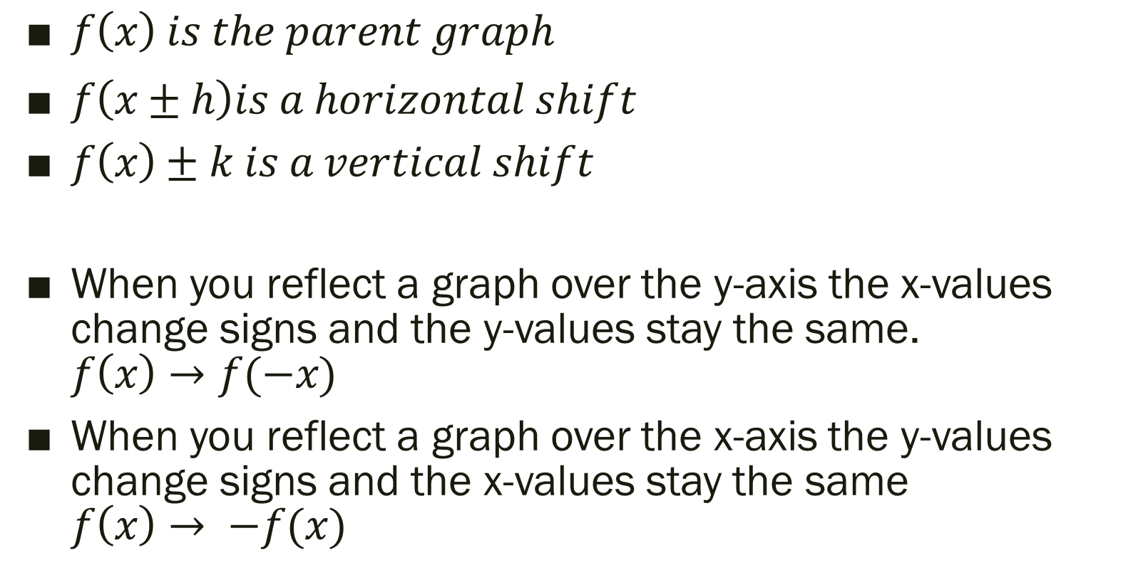
Types of Transformations
$f\left(x\right) is the parent graph$
$f\left(x±h\right)is a horizontal shift$
$f\left(x\right)±k is a vertical shift$
When you reflect a graph over the y-axis the x-values change signs and the y-values stay the same. $f\left(x\right)→f(−x)$
When you reflect a graph over the x-axis the y-values change signs and the x-values stay the same $f\left(x\right)→ −f(x)$

Slide 17

Example (Using Graphing Calculator): Describe the transformation.
Parent Graph $f\left(x\right)=x^{2}$
1.) $f\left(x\right)={(x−4)}^{2}$
2.) $f\left(x\right)=x^{2}+3$
3.) $f\left(x\right)={(x+2)}^{2}−5$
4.) $f\left(x\right)=−5({x−1)}^{2}+6$

Slide 18
For Next Time…
New Material (Section 2.5)
Page 96 #1, 7, 9, 13, 15-17, 27
New Material (Section 2.6)
Page 103 #5, 6, 13, 19-21, 55

